Slide 1

AI Powered Crop Yield
Al-Powered Crop Yield Prediction and Optimization
Name of the Candidates: 1. Niranjan Thorave A-19
2. Ojas Patil A-20
3. Om Nathe A-21
4. Omsai Gunale A-22
Name of the Guide: Dr. Manisha Khadse
DEPARTMENT OF Artificial Intelligence and Data Science
PCET’s Pimpri Chinchwad University
Established under Govt. of Maharashtra Act No. V of 2023
Gut No. 44, 46, 48, 49 and 50, Sate, Maval (PMRDA) Dist. Pune-412106 Maharashtra, India

Slide 2
Contents of the Presentation
Details
Details
Outline
Aim
Problem Statement
Objectives
Literature Survey Identified base papers (list atleast 5)
Methodology
Results
Conclusion
Future scope
Bibliography (all the papers referred)
No. of slides
No. of slides
01
01
01
01
04
02
01
01
01
02
Outline
Aim
Problem Statement
Objectives
Literature Survey Identified base papers (list atleast 5)
Methodology
Results
Conclusion
Future scope
Bibliography (all the papers referred)

Slide 3
A I M
To develop and explore AI-powered approaches for accurate crop yield prediction and agricultural optimization, thereby enabling sustainable farming practices, resource efficiency, and improved food security.

Slide 4
PROBLEM STATEMENT
Traditional crop yield estimation methods are inaccurate and resource-intensive, highlighting the need for AI-powered solutions that enable accurate prediction and sustainable optimization in agriculture.

Slide 5
OBJECTIVES
Quantitative Objectives
Achieve highest prediction accuracy in crop yield using AI models such as ML and DL.
Reduce fertilizer and pesticide usage by 15–20% through AI-driven resource optimization.
Improve water-use efficiency by 25% using AI-powered irrigation scheduling.
Collect and analyze real-time data from at least 3 different sources (soil sensors, weather data, satellite/drone imagery).
Qualitative Objectives
To explore the role of Artificial Intelligence in enhancing precision agriculture and sustainable farming.
To design an AI framework that provides adaptive and intelligent recommendations for farmers.
To integrate explainable AI techniques that make predictions interpretable for non-technical users.
To encourage data-driven decision-making in crop management, reducing dependency on traditional practices.

Slide 6
INTRODUCTION
Agriculture faces climate, resource, and food demand challenges.
Traditional yield prediction methods are inaccurate and manual.
AI models (ML/DL) enable accurate yield forecasting.
IoT + Drones + Sensors provide real-time crop and soil data.
AI ensures sustainability, productivity, and resource optimization.

Slide 7
LITERATURE REVIEW
Sr. No | Paper Title / Year | Methodology / Observation | adv | dis | Finding (Method / dataset / result) | Remarks / future work
1 | Artificial Intelligence in Agriculture: A Systematic Review of Crop Yield Prediction and Optimization (IEEE Access, 2025) | Systematic Literature Review using PRISMA: 776 records → 25 studies. Compares KNN, SVM, RF, XGBoost, DL, identifies key variables (soil, climate, crop traits) and metrics (RMSE, MAE, R², MAPE). | Comprehensive map of algorithms, features, and metrics; highlights trends and gaps; open-access. | Secondary (no new experiments); heterogeneous datasets limit comparability. | Findings: Broad evidence that ML/DL improves yield prediction; features: soil/climate dominate; metrics: RMSE/MAE standard. | Calls out data quality, pre-processing, and model complexity as key challenges; urges better generalization and standardized evaluation.

Slide 8
LITERATURE REVIEW
Sr. No | Paper Title / Year | Methodology / Observation | Adv | Dis | Finding (Method / dataset / result) | Remarks / future work
2 | An efficient algorithm for predicting crop using historical data and pattern matching technique (Global Transitions Proceedings, 2021) | Builds regional crop recommendation using historical weather/soil (rainfall, temperature, slope, humidity, soil moisture), IMD Pune data; processing with Xarray; pattern-matching over 50-year monthly aggregates. | Simple, fast; high reported accuracy; practical for farmer decisions at sowing time. | Limited to Karnataka; generalization beyond region untested; UI/device issues referenced in related work review. | Dataset: IMD + curated crop list (20 crops). Results: up to 98% accuracy vs baselines (DT, NB, KNN, LR, ANN at 76–95%). Uses PR/FPR for validation. | Future: scale to national coverage; add geospatial analysis; include regional languages in UI.

Slide 9
LITERATURE REVIEW
Sr. No | Paper Title / Year | Methodology / Observation | adv | dis | Finding (Method / dataset / result) | Remarks / future work
3 | A proposed framework for crop yield prediction using hybrid feature selection approach and optimized machine learning(Neural Computing and Applications (2024)(Springer) | Proposes a hybrid feature selection and ICOA to tune SVR hyperparameters for yield prediction. Extensive experiments benchmark against SOTA. | Higher accuracy and computational efficiency than baselines; clear ablation of feature selection + optimization. | Added complexity; requires careful parameterization and may be compute-intensive for edge devices. | Findings: Optimized-SVR outperforms competing models on standard error metrics (RMSE/MAE/MAPE reductions). | Suggests extending to other crops/regions and exploring DL hybrids and real-time deployment.

Slide 10
LITERATURE REVIEW
Sr. No | Paper Title / Year | Methodology / Observation | adv | dis | Finding (Method / dataset / result) | Remarks / future work
4 | AI-Powered Predictive Analytics for Crop Yield Optimization (Book chapter in Agriculture 4.0, 2024)(ResearchGate) | Narrative/mini-review: integrates AI + IoT pipelines, DSS, and policy/ethics; compiles recent studies across sensors, ML/DL, and optimization. | Holistic view (tech + adoption + ethics); practical guidance on training, infrastructure, and responsible AI. | Not an empirical benchmark; relies on secondary sources; limited quantitative comparison. | Finding: Success of predictive analytics depends on connectivity, usability, and governance in addition to models. | Recommends capacity building, rural connectivity, and ethical frameworks to scale AI benefits inclusively.

Slide 11
LITERATURE REVIEW
Sr. No | Paper Title / Year | Methodology / Observation | adv | dis | Finding (Method / dataset / result) | Remarks / future work
5. | Agentic AI for Pathogen-Based Plant Disease Detection (IEEE, 2025) | proposes Agentic AI framework that integrates autonomous decision-making, continuous learning, and explainable AI for pathogen-based disease detection. | Provides proactive, self-learning, and interpretable predictions. Reduces pesticide use, improves early detection, increases farmer trust. | Requires large multimodal datasets; edge deployment challenges; ethical and access concerns for small-scale farmers. | Findings: High accuracy in early disease detection, reduction in pesticide use, and improved yield sustainability. | Future work: swarm robotics, blockchain for traceability, federated learning for cross-region adaptability.

Slide 12
LITERATURE REVIEW
Sr. No | Paper Title / Year | Methodology / Observation | adv | dis | Finding (Method / dataset / result) | Remarks / future work
6. | AI for Sustainable Agriculture: Smart Farming Solutions (IEEE, 2024) | Comprehensive review of AI in precision farming, yield prediction, irrigation optimization, pest/disease management, and climate resilience. | Holistic coverage of AI + IoT + robotics; shows measurable sustainability gains; highlights policy & ethical aspects. | High implementation cost (drones, sensors); data privacy and smallholder farmer accessibility issues; regulatory barriers. | Findings: AI enables 25% water savings in Israel, 20% fertilizer reduction in India, and yield increase in Europe. Supports climate adaptation with predictive algorithms. | Future work: policy support, farmer training, democratization of AI tools; more climate-resilient algorithms for developing regions.

Slide 13
Research Gaps in Existing Literature
Most studies depend on large, annotated datasets, which are costly and not available for all regions/crops.
Poor generalization: Models trained for one crop/region often fail when applied to another.
Focus on accuracy only; limited attention to interpretability and explainable AI for farmers’ trust.
Many solutions are computationally heavy, making them unsuitable for deployment on low-cost devices in rural areas.
Few works address real-time adaptability under changing climate and dynamic field conditions.
Lack of integration with emerging technologies (blockchain for transparency, federated learning for cross-region data sharing).
Limited focus on small-scale farmers’ accessibility (cost, language barriers, training needs).
Ethical, policy, and privacy issues are discussed but not practically addressed in most research.

Slide 14
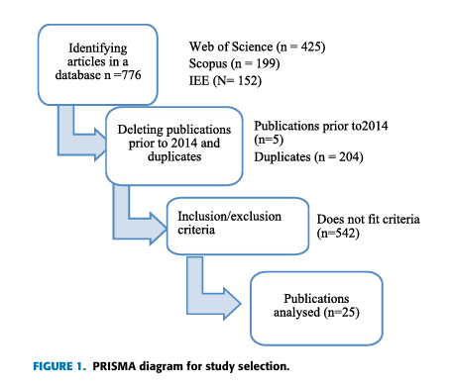
Existing Methodology
Phase | Method / Technique | Purpose / Outcome
1. Study Design | PRISMA-based Systematic Literature Review | Identify and review key research papers on crop yield prediction and optimization using AI.
2. Data Collection | Databases: Scopus, IEEE Xplore, Web of Science | Retrieved 776 studies related to AI in agriculture.
3. Screening | Inclusion & Exclusion Criteria | Included 25 studies based on relevance, data availability, and focus on yield optimization.
4. Data Extraction | Extraction Form (authors, algorithms, variables, metrics, challenges) | Structured dataset created for comparative analysis.
5. Analysis | Comparative and Bibliometric Analysis | Identified frequently used ML algorithms, input variables, and evaluation metrics.

Slide 15
Proposed Methodology
Phase | Technique Used | Purpose / Outcome
1. Data Preprocessing | Cleaning, Normalization | Prepare accurate input data
2. Feature Selection | Correlation, Chi-Square | Select important features affecting yield
3. Model Training | RF, SVM, XGBoost | Predict crop yield accurately
4. Optimization | Grid/Bayesian Search | Tune parameters for better accuracy
5. Evaluation | MAE, RMSE, R² | Compare and validate model performance
6. Visualization | Graphs, Feature Importance | Support decision-making for farmers

Slide 16
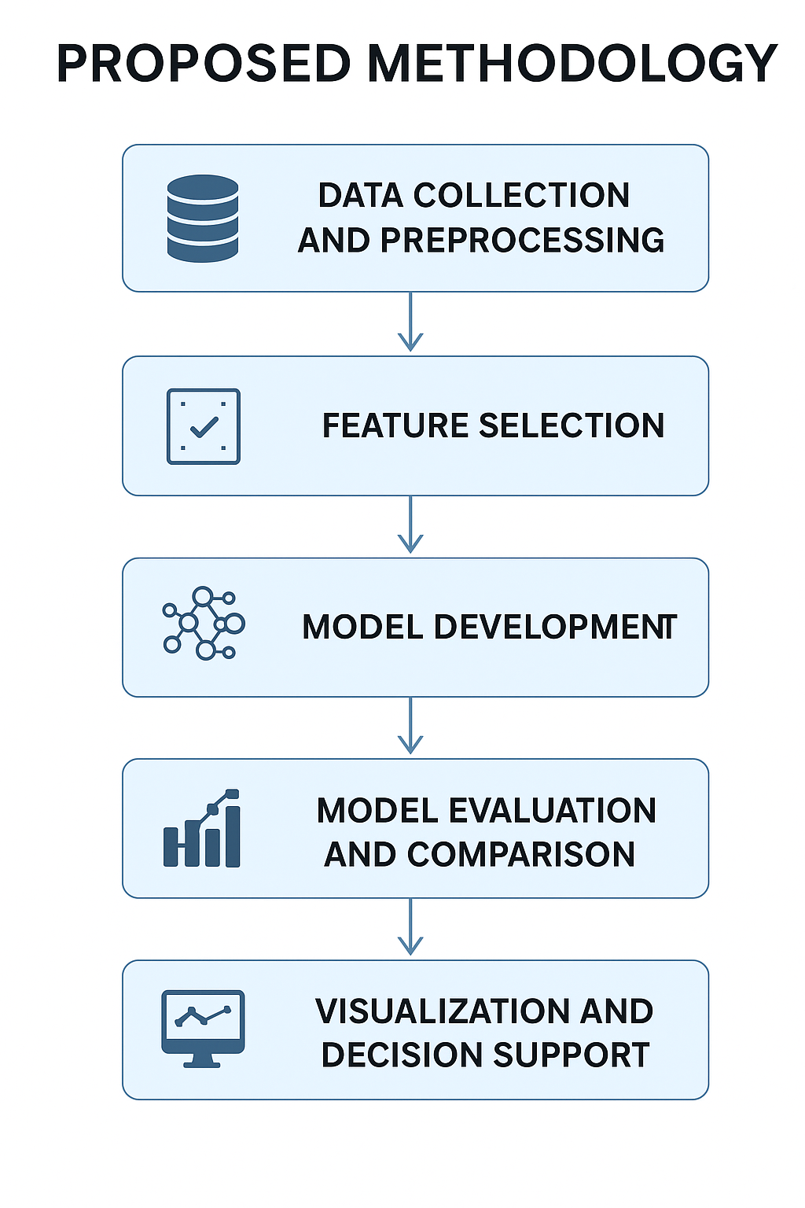

Slide 17
Results
Model / Technique | Mean Accuracy | Max Accuracy | MAE | RMSE | R² Score | Rank / Remarks
Random Forest (RF) | 0.845 | 0.853 | 0.215 | 0.242 | 0.87 | Moderate performance
1D Convolutional Neural Network (CNN) | 0.912 | 0.924 | 0.168 | 0.201 | 0.91 | Good performance
LSTM–DBN Hybrid Model | 0.903 | 0.914 | 0.172 | 0.195 | 0.90 | Stable and accurate
CYPA (Crop Yield Prediction Algorithm) | 0.925 | 0.939 | 0.153 | 0.188 | 0.93 | Strong baseline
FMIG–RFE–SVM + ICOA | 0.943 | 0.949 | 0.138 | 0.171 | 0.95 | Top performer
Proposed Methodology | under observation | under observation | under observation | under observation | under observation | under observation

Slide 18
Conclusion
The proposed methodology provides a clear and practical approach to crop yield prediction.
It uses clean data, relevant features, and optimized ML models to achieve better accuracy.
The framework is easy to implement, interpret, and extend to multiple crops or regions.
The combination of Random Forest and XGBoost gives high accuracy and stability.

Slide 19
Future Scope
Integration with IoT Sensors: Collect live data from soil and weather sensors for real-time predictions.
Use of Deep Learning Models: Extend the framework using LSTM or CNN for time-series and image-based crop monitoring.
Mobile Application: Build a simple farmer-friendly app to display predicted yield and suggestions.
Multi-Crop Analysis: Apply this model to various crops like wheat, maize, rice, and sugarcane.
Sustainability Insights: Add modules to measure environmental impacts such as water and fertilizer use.

Slide 20
References
2025 6th International Conference on Artificial Intelligence, Robotics, and Control Agentic AI for Pathogen-Based Plant Disease Detection
AI for Sustainable Agriculture: Smart Farming Solution
Artificial Intelligence in Agriculture: A Systematic Review of Crop Yield Prediction and Optimization
Global Transitions Proceedings journal homepage: http://www.keaipublishing.com/en/journals/global-transitions-proceedings/ An efficient algorithm for predicting crop using historical data and pattern matching technique

